Slide 1
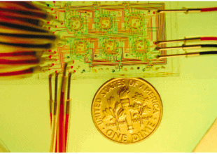
Microfluidic Background Information

Slide 2
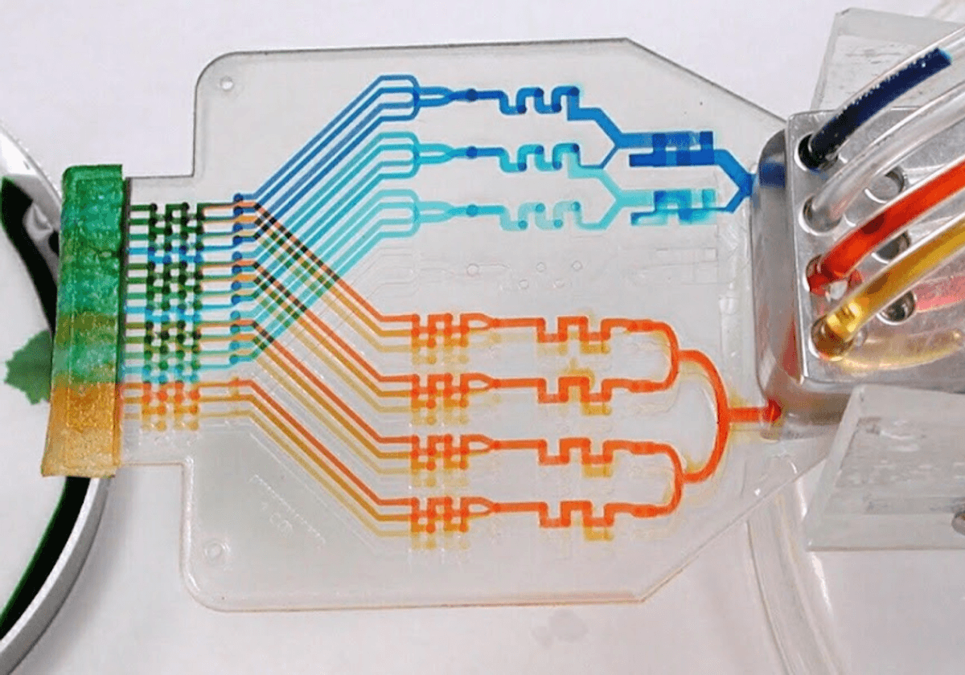
What is Microfluidics?
The application of science & technology to manipulate tiny fluid volume (nanolitres-microlitres) in microscale channels
Complex lab functions can be scaled down and simplified
Known as “lab-on-a-chip”
Characteristic Physics:
Predominantly laminar (non-turbulent) flow)
Precise temporal and spatial control of fluid movement
Used in physics, chemistry, biology and engineering applications.

Slide 3
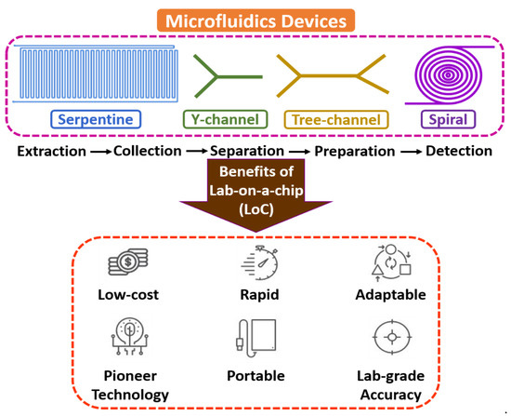
Benefits
Reduces sample and reagent consumption (cost)
Point-of-use application
Integrates multiple laboratory steps on a chip
Rapid development of process line and fast analysis

Slide 4
Main Application Fields I
Biomedical and Life Sciences
Point-of-care (at the time and place of a patient care/in the moment) diagnostics
E.g. for blood or infectious diseases
DNA/RNA, protein analysis and PCR tests
Single cell studies and cell manipulation
Organ-on-a-chip models
Pharmaceutical Sciences
Drug screening and formulation
Synthesis of nanoparticles and lipid carriers

Slide 5
Main Application II
Environmental and Food Monitoring
Detection of pollutants, contaminants
Agricultural biosensing
Chemical Analysis and Synthesis
Miniaturised reactors and rapid chemical synthesis
Reaction optimisation
Industrial/Basic Research
Synthesis of micro/nanoparticles
Studies of fluid physics at the microscale

Slide 6
Presentation Contents
Microfluidic Focus:
Point-of-care (POC) devices
In-vitro diagnostics (IVD)
Lipid nanoparticles (LNP) mixing applications
content:
Chip design
Materials
Manufacturing/Fabrication
Roll-to-Roll vs. Injection Moulding
Recommendations

Slide 7
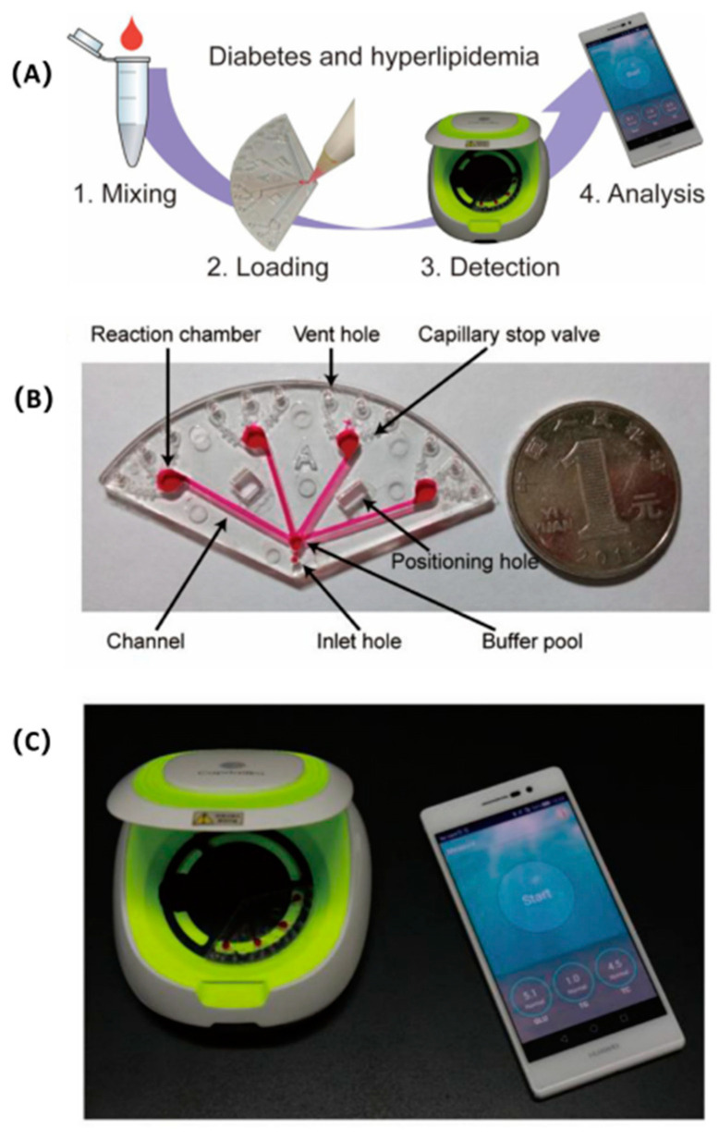
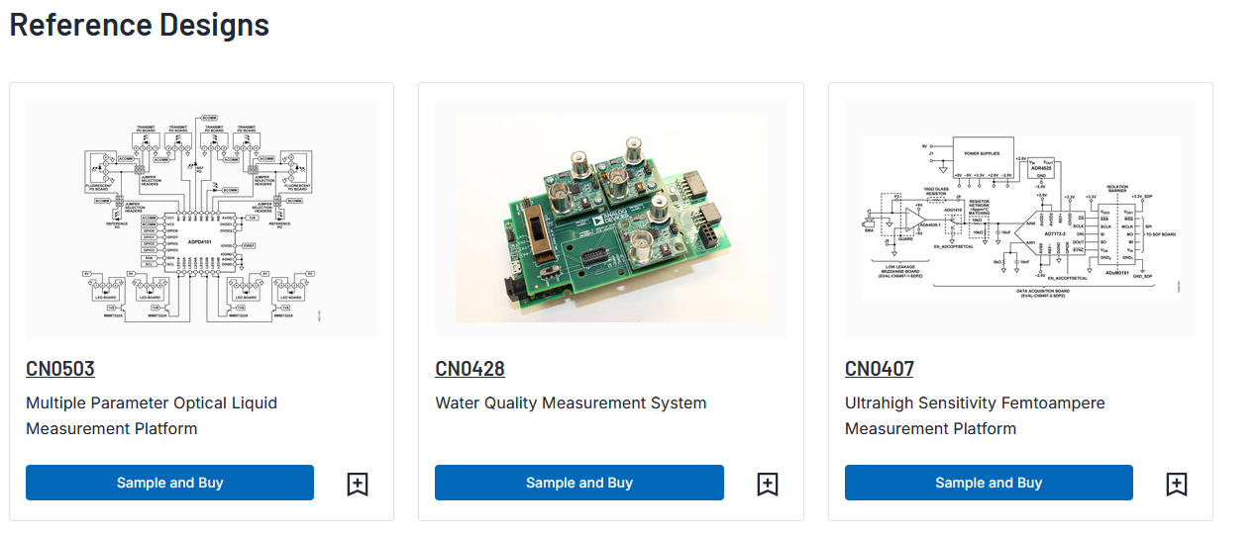
Application fields of Microfluidic Chips
POC Diagnostics
Rapid, on-site disease testing (e.g. HIV, COVID-19) compared to lab equipment
Small sample volumes (20-30 µL), fast results (10-30 min)
Portable, often single use
Detection Methods: Optical/Molecular/Smartphone
Multipurpose PoC can identify multiple diseases using electronic devices
Notes:
POC
https://pmc.ncbi.nlm.nih.gov/articles/PMC8875995/
https://www.ufluidix.com/microfluidics-applications/microfluidic-devices-for-point-of-care/
https://www.elveflow.com/blog/transforming-healthcare-microfluidic-chips-in-point-of-care-diagnostics
IVD

Slide 8
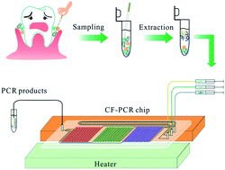
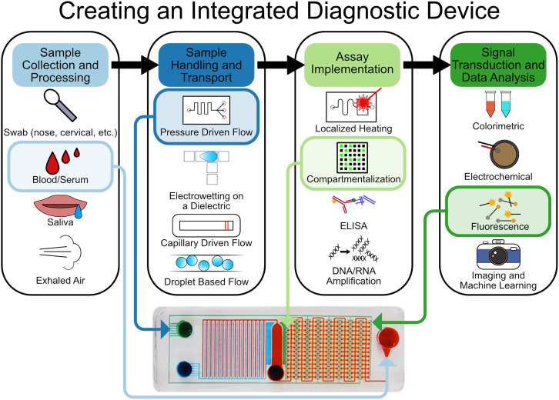
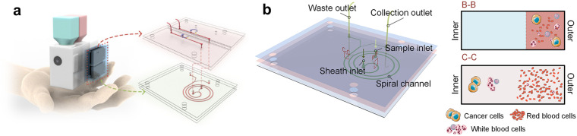
Application fields of Microfluidic Chips
IVD (In Vitro Diagnostics)
Automated, compact molecular, protein and genetic analysis
“Miniturising complex assays on low cost platforms”
Multiplexed, high-throughput for microfluidics
Lab-quality results in closed, safe system … difficult to scale up
Notes:
IVD
https://en.seamaty.com/index.php?s=/sys/483.html
https://www.creative-biolabs.com/drug-discovery/diagnostics/microfluidics.htm
https://pmc.ncbi.nlm.nih.gov/articles/PMC9469643/

Slide 9
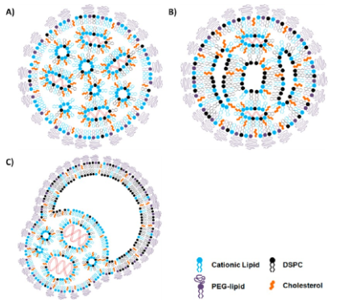
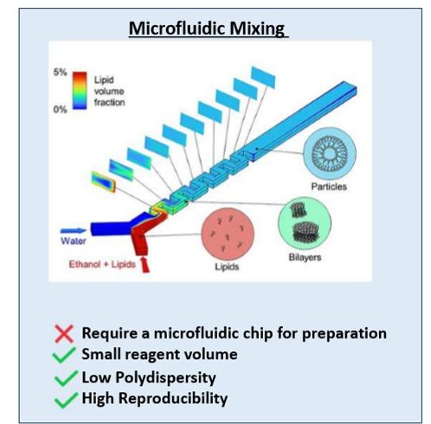
Application fields of Microfluidic Chips
LNP Mixing (Pharma/Biotech)
LNP’s are encapsulated lipids (e.g. mRNA), used as nano-delivery vehicles for cytotoxic chemotherapy/antibiotics and nucleid acid therapeutics
= Drug delivery
Controlled mixing via (chaotic) microstructures
E.g. Herringbone mixers
LNP structure dependent on lipid and nucleic acid concentration at input
E.g. lipid-in-ethanol solution
Some literature regarding scalable and precise pharma manufacturing
Challenging!
Notes:
LNP
https://www.liposomes.ca/publications/2010s/Leung%20et%20al%202015%20-%20Microfluidic%20Mixing%20-%20A%20General%20Method%20for%20Encapsulating%20Macromolecules%20in%20Lipid%20Nanoparticle%20Systems.pdf
https://www.nature.com/articles/s41598-022-13112-5
https://journals.plos.org/plosone/article?id=10.1371/journal.pone.0187962
https://academic.oup.com/jpp/article/76/12/1572/7816331

Slide 10
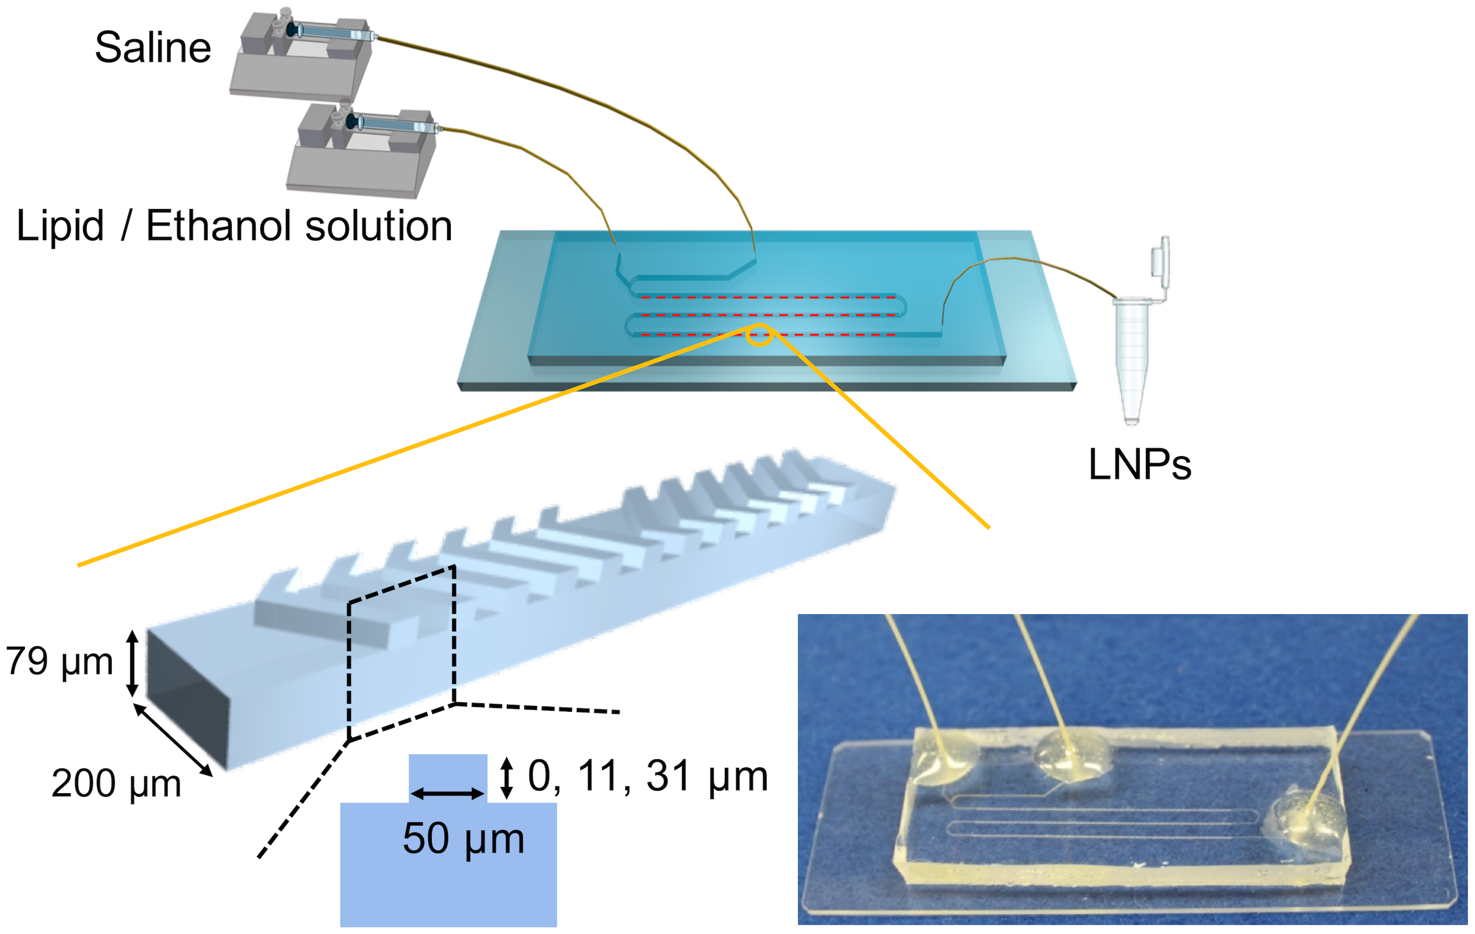
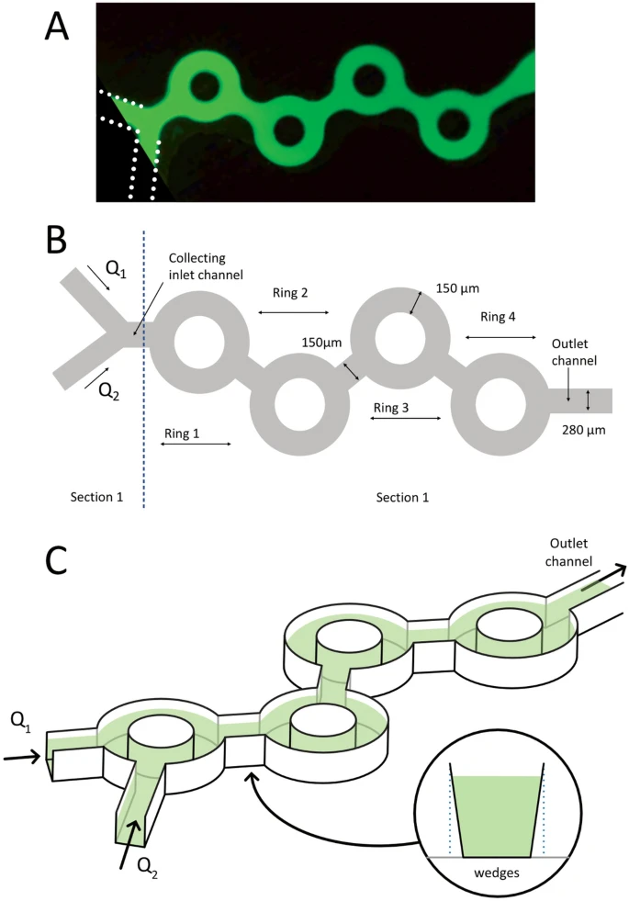
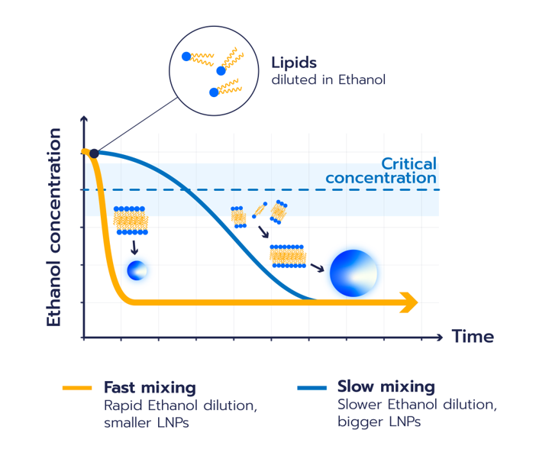
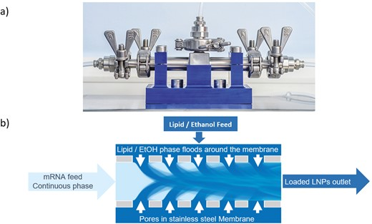
LNP Mixing
Notes:
https://www.nature.com/articles/s41598-022-13112-5
https://journals.plos.org/plosone/article?id=10.1371/journal.pone.0187962
https://academic.oup.com/jpp/article/76/12/1572/7816331

Slide 11
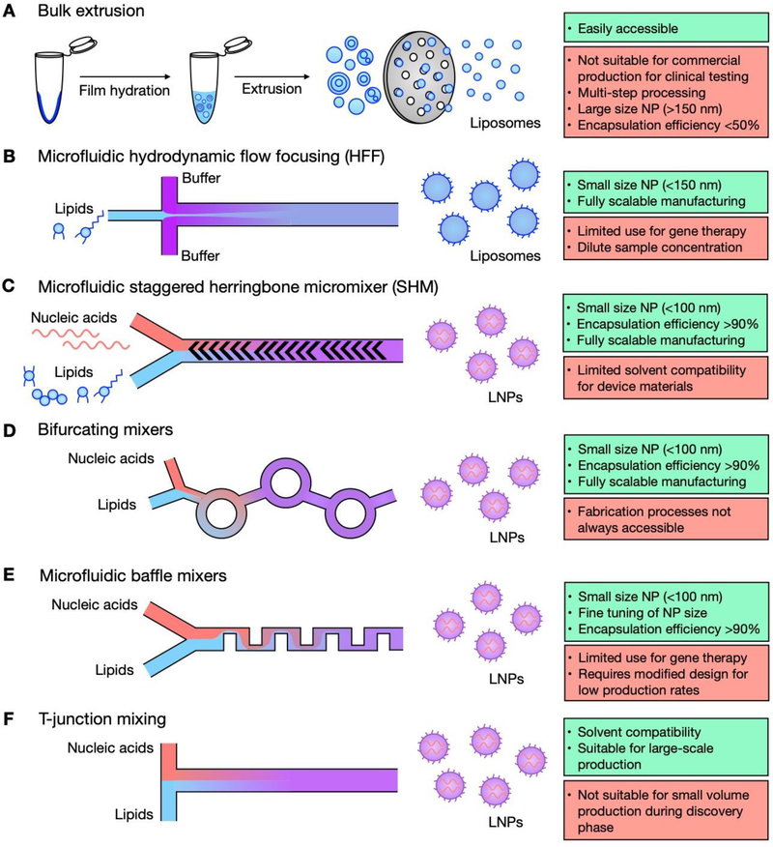
Notes:
https://europepmc.org/article/pmc/pmc8752123

Slide 12
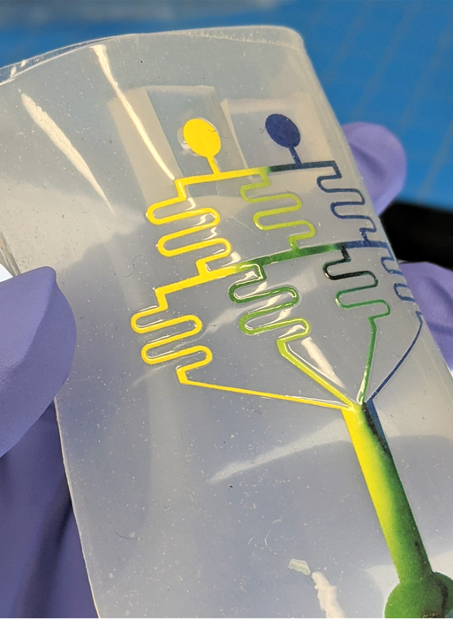
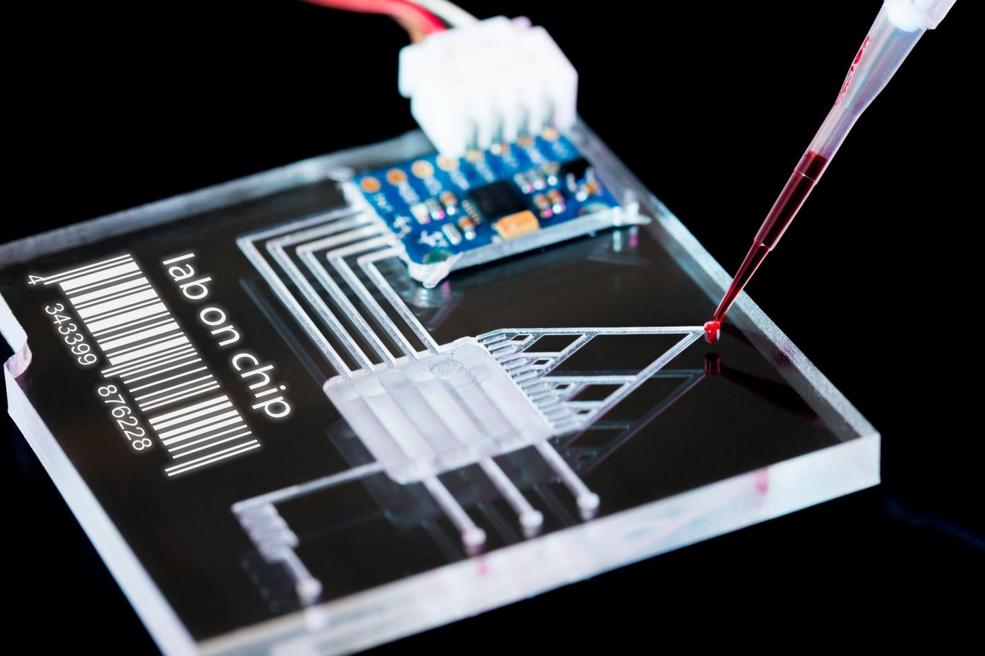
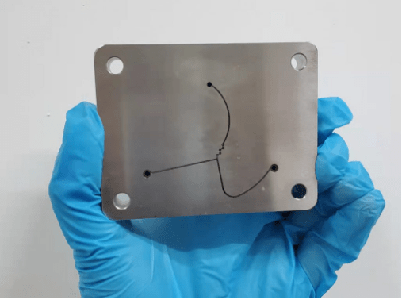
Materials
What factors go into material selection
Chemical and biologic, and thermal compatibility with intendent reagents, products, and reaction type.
Optical properties
Mechanical properties
Cost, Scalability, and ease of fabrication

Slide 13
Materials
Materials | Major Properties | Applications / Notes | Basic Fabrication Method | Potential Pain Points
Polydimethylsiloxane (PDMS) | Flexible, transparent, gas permeable, biocompatible | Rapid prototyping, biological assays | Soft/Photo lithography | Delicate and chemically permeable
Glass | Chemically resistant, optically transparent | High-pressure and chemical applications | Soft lithography, CNC/micromachining | Microfabrication difficulties, cost, labour intensive
Silicone | Mechanically robust, precise fabrication | Early microfluidic & high performance devices | 3D printing, soft lithography | Opacity renders it useless for optical applications
Thermoplastics (PMMA, COC, COP, PC) | Inexpensive, mass manufacturing, variable transparency | Disposable devices, commercial chips | Embossing, moulding, 3D printing, laser CNC/micromachining | Some manufacturing methods aren’t great for mass production
Paper | Wicking via capillary action, cheap, disposable | Point-of-care, resource-limited diagnostics | Other | Limited use case
Metals | High durability, temperature and pressure tolerance | Specialised applications & High throughput | CNC/micromachining | Opaque, microfabrication difficulties and cost

Slide 14
Design & Structure
 | POC | IVD | LNP
Channel Dimensions | 20-500 µm width; 10-300 µm height | 50-300 µm width; 20-200 µm height | 100-700 µm width; 50-200 µm height
Device size | Approx. 26x59mm, 2.2mm thickness | Approx. 70x15 mm | Approx. 62x41mm
Critical feature tolerances | +/- 10-20 µm | +/- 15 µm | +/- 5-10 µm
Flow Rates | n/a | n/a | 10-500 mL/min
Common materials | PDMS (R&D/Research), thermoplastics (commercial) | Thermoplastics (chemical resistance) | Thermoplastics
Common manufacturing | n/a | High-volume via injection moulding | n/a
Other details | … | … | Low Reynolds number

Slide 15
Design & Structure
Conclusion (1): Channel Dimensions & Device Size dependent on microfluidic application
Conclusion (2): Manufacturing tolerance should be 5-20 µm
Conclusion (3): LNP surface finish should ensure low Reynolds number for non-time-dependent and chaotic mixing

Slide 16
Manufacturing
Main purpose:
One off/Accuracy
Scalability/batch … INC: “Industrialisation and automation”
Paralysation
Manufacturing Methods
Most Common →
Direct Fabrication
Replication-Based
Method | Materials | Feature Resolution (µm)
Soft Lithography | PDMS, glass, thermoplastics | 50-100 nm
Photo Lithography | PDMS, glass, thermoplastics | 50-100 nm
3D Printing/Additive Manufacturing | Plastics, silicone | 30-1000
Notes:
3D printing - https://www.sciencedirect.com/science/article/pii/S02641275230
Soft Litography - Soft Lithography for Microfluidics: a Review
Diagram - https://www.researchgate.net/publication/370866004_Microfluidic_Device_for_the_Manipulation_of_Microparticles_for_Flow_Cytometry_Application

Slide 17
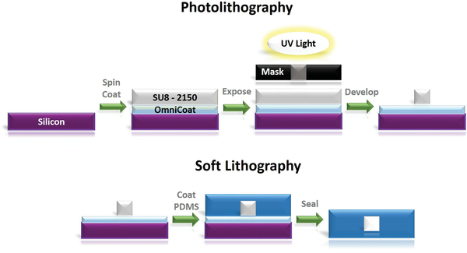
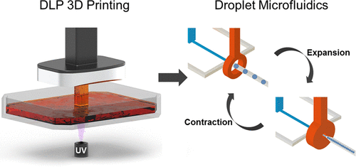

Slide 18
Manufacturing – Replication Based Methods
Method | Scale | Materials | Feature Resolution (µm) | Main Use
Casting | Low/Medium | PDMS, elastomers | Dependent | Rapid prototyping
Lamination | Medium | Polymers, adhesives | 50-500 | Multilayer chips
Hot embossing | High | Thermoplastics | 1-100 | Mass production
Injection Moulding | High | Thermoplastics | 1-100 | Commercial batches
Film or Roll-to-Roll | High | Polymers, films | 1-100 | Disposable batches
Notes:
https://pmc.ncbi.nlm.nih.gov/articles/PMC8002879/
https://www.mdpi.com/2411-5134/3/3/60
https://pmc.ncbi.nlm.nih.gov/articles/PMC7921936/
https://pmc.ncbi.nlm.nih.gov/articles/PMC9147778/
https://www.nature.com/articles/s41598-024-80332-2

Slide 19
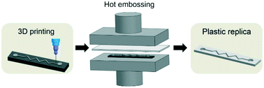
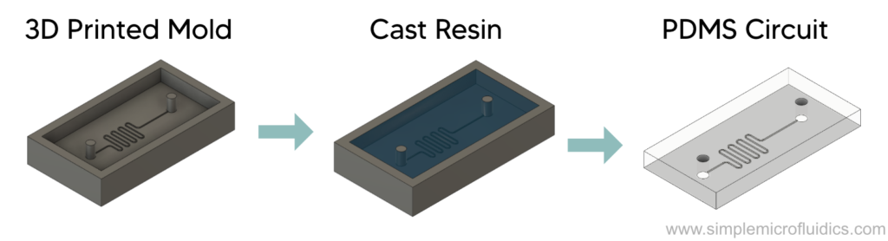
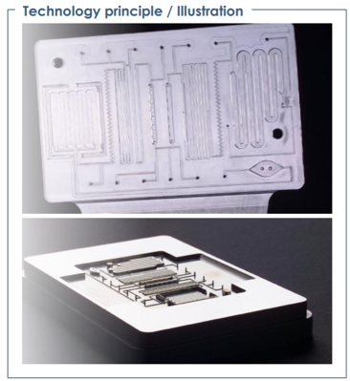
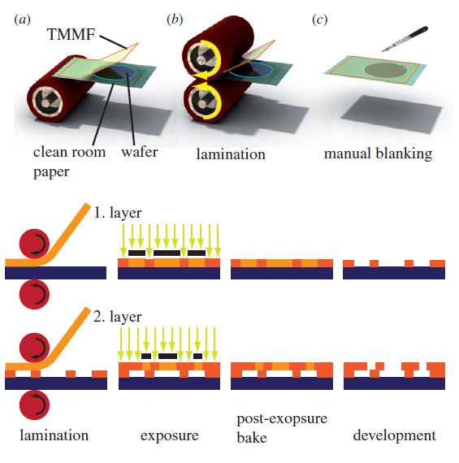
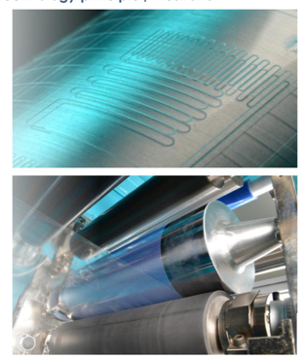
Hot embossing
Casting
Injection Moulding
Lamination
Film or Roll-to-Roll

Slide 20
Manufacturing – Direct Fabrication Method
Method | Scale | Materials | Feature Resolution (µm) | Main Use
Micro-Cutting (Mechanical Micromachining) | Low/Medium | Polymer, metal | 50-100 | Prototyping, masters
Ultrasonic Machining | Low | Ceramics, glass | 10-100 | Special substrates
Electro discharge Machining (EDM) | Low/Medium | Metals, conductive | 10-50 | Metal masters
Electrochemical Machining (ECM) | Low/Medium | Metals, conductive | 10-100 | Intricate features
Laser Ablation | Low | Polymers, glass | 1-50 | Fast Prototyping
Electron Beam (E-Beam) Machining | Low | Resists, metals | 10 | Master structures
Focused Ion Beam | Low | Polymers, metals | <1 | Nano masters
Notes:
https://pmc.ncbi.nlm.nih.gov/articles/PMC8002879/
https://www.mdpi.com/2411-5134/3/3/60
https://pmc.ncbi.nlm.nih.gov/articles/PMC7921936/
https://pmc.ncbi.nlm.nih.gov/articles/PMC9147778/
https://www.nature.com/articles/s41598-024-80332-2

Slide 21
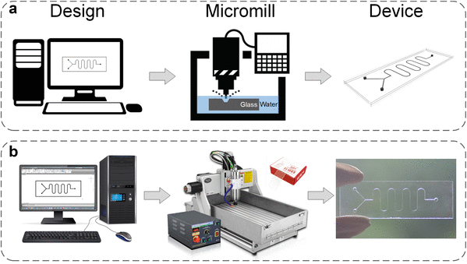
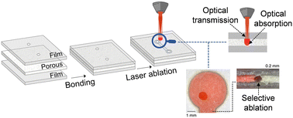
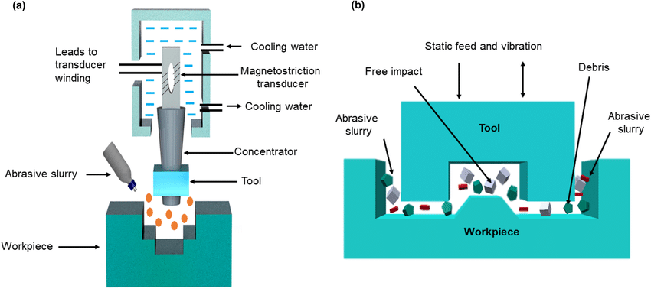
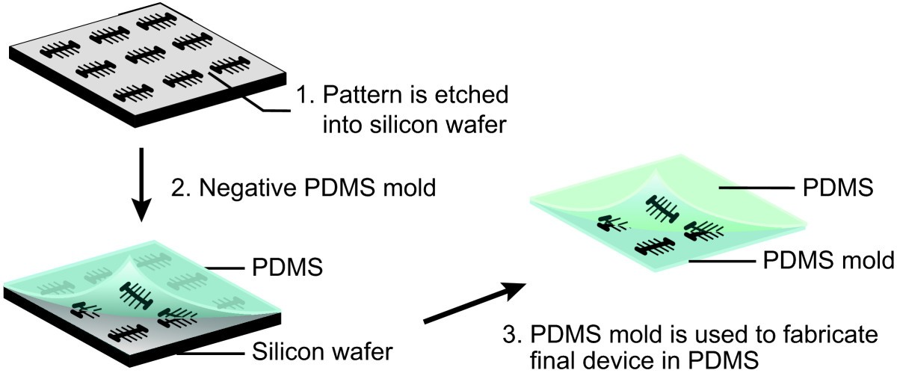
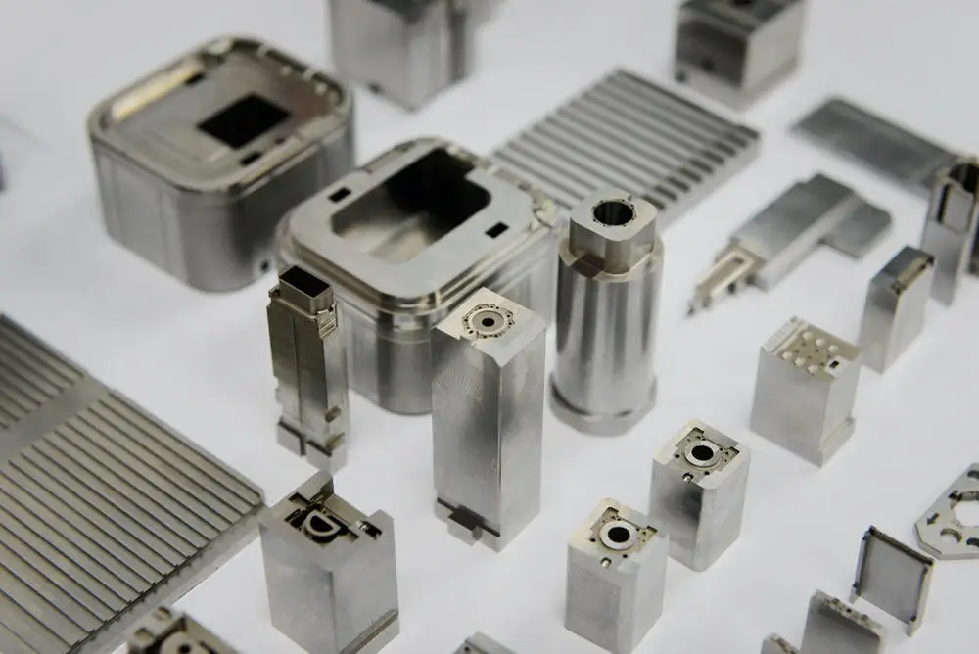
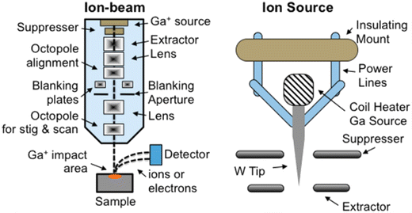
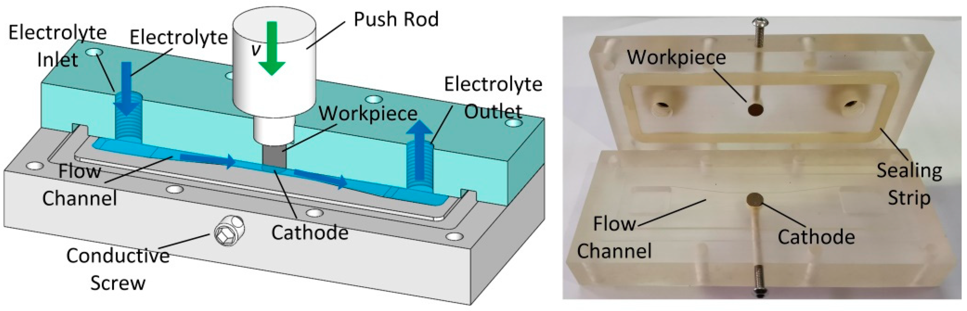
Micro-Cutting (Mechanical Micromachining)
Laser Ablation
Ultrasonic Machining
Electron Beam (E-Beam) Machining
Electro discharge Machining (EDM)
Focused Ion Beam
Electrochemical Machining (ECM)

Slide 22
Roll-to-Roll vs. Injection Moulding

Slide 23
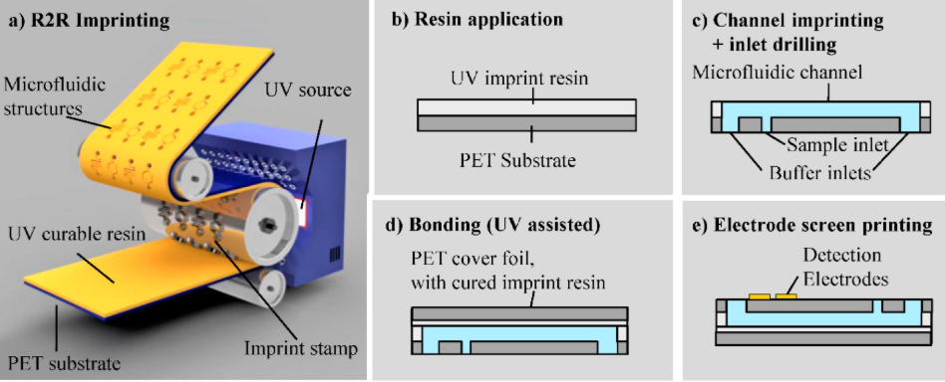
Roll-to-Roll
R-t-R Process
Liquid UV curable resin is applied to a polymer substrate (PET, Kema foil HSPL80)
A cylindrical imprint stamp continuously presses into the resin layer
UV exposure through PET initiates curing, replicating the stamp pattern
Produces microfluidic channels continuously
Notes:
Kilas reference: R2R: MDPI and ACS Style
Smolka, M.; Ruttloff, S.; Nees, D.; Prietl, C.; Satzinger, V.; Lamprecht, B.; Hütter, P.; Hesse, J.; Kokkinis, G.; Kriechhammer, G.; et al. High Throughput Roll-to-Roll Production of Microfluidic Chips. Proceedings 2018, 2, 1054. https://doi.org/10.3390/proceedings2131054

Slide 24
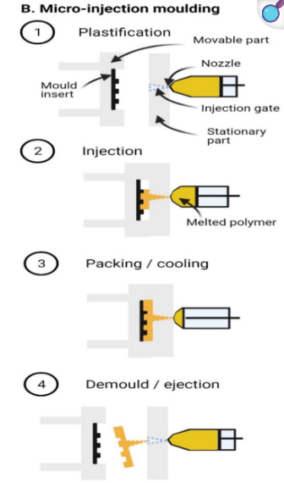
Injection Moulding
Injection Moulding
Micro-injection moulding creates high-quality, precise parts
Hot melt polymer is injected into a mould, cooled and demoulded
Offers replicability, cost-effectiveness and automation
Ideal for mass production of disposable products
Supports a wide range of thermoplastics

Slide 25
Injection Moulding & R-t-R Comparison
Factor | Injection Moulding | Roll-to-Roll | Lithography
Accuracy | 0.5-5 µm | 10-50 µm | 1-2 µm (best is 100µm)
Throughput | 1000s-100000s | 100,000-continous | <1000 (mainly used for R&D/prototyping)
Material | Most Thermoplastics | Flexible polymers, some thermoplastics | Photoresist, PDMS, glass
Setup Cost | High | Very high, but reduces with per unit cost | Low-medium
Complexity | Good for complex geometries | Challenging for complex 3D geometries | Best for fine details
Notes:
https://pmc.ncbi.nlm.nih.gov/articles/PMC8002879/
https://www.mdpi.com/2411-5134/3/3/60
https://www.frontiersin.org/journals/bioengineering-and-biotechnology/articles/10.3389/fbioe.2024.1421831/full
https://www.nature.com/articles/nprot.2009.234
https://www.sciencedirect.com/science/article/pii/S0168365922000918
https://link.springer.com/article/10.1007/s44371-025-00133-y

Slide 26
Feasibility and Best Use Cases
Injection Moulding
Highly feasible for commercial, high-volume production
Best accuracy and broad material options
Requires significant upfront investment
Roll-to-Roll
Excellent for low-cost, mass production (e.g. disposable)
Moderate accuracy, limited to certain designs and flexible materials
Ideal for paper or film based diagnostic strips (and sometimes electronics!)
Lithography (Soft/Photo)
Gold standard for research, prototyping and designs requiring sub-micron precision
Limited scalability for routine high-volume manufacturing

Slide 27
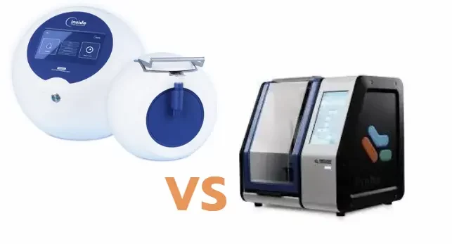
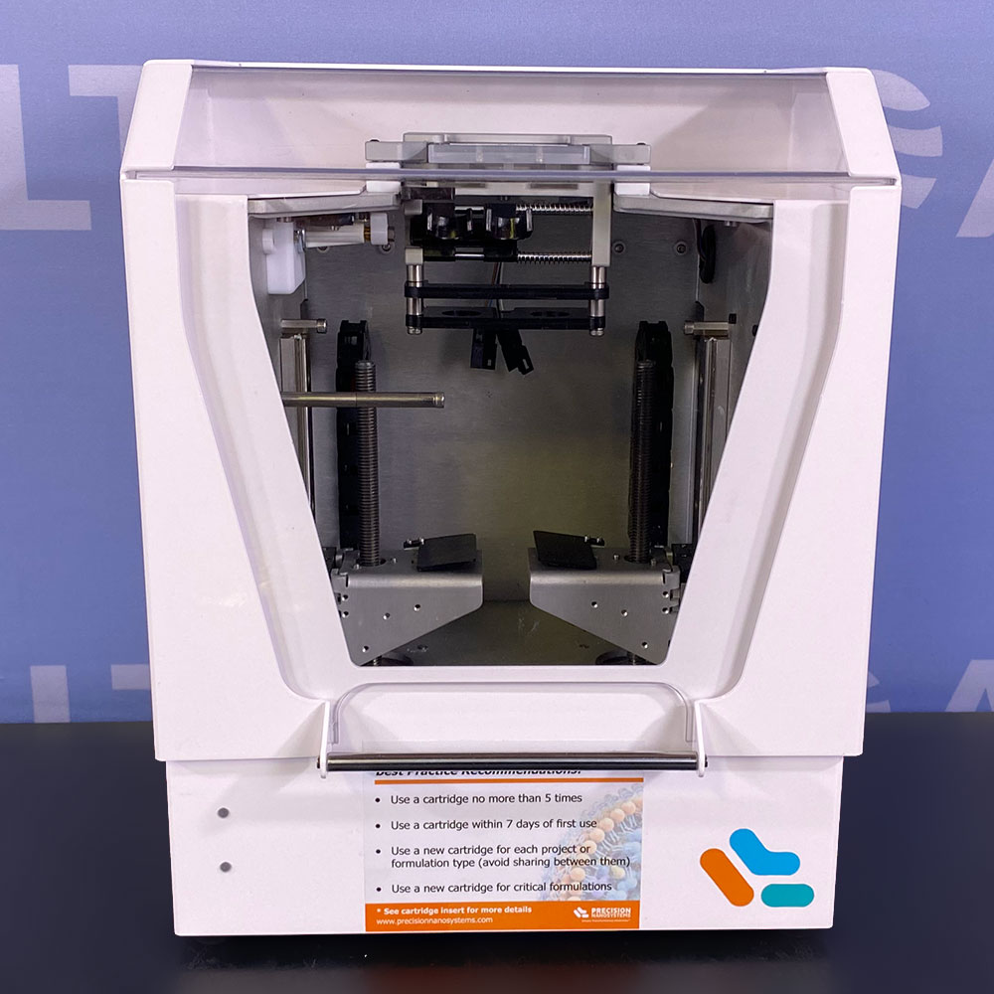
Recommendations
LNP pharmaceutical chips
Use injection moulding for commercial scale & lithography for R&D
(Disposable) Diagnostics
Roll-to-Roll for mass-market, cost-sensitive use
Conclusion
Manufacturing method is dependent on microfluidic use case (POC/IVD/LNP), design and scaling method
Further research needs to be done into method of scaling up
E.g. using chip, channel paralysation or 3rd party flow rate machine

Slide 28
Appendix

Slide 29
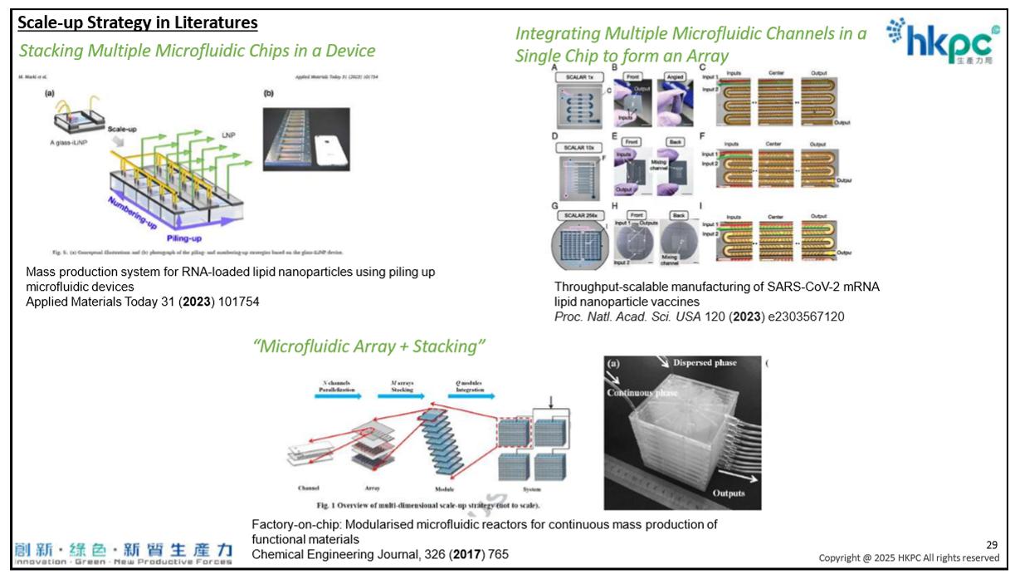
Scaling

Slide 30
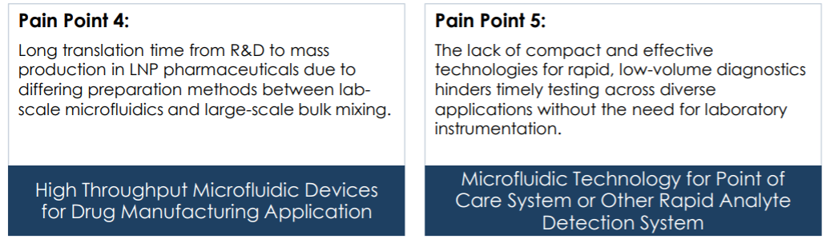
INC & NLP

Slide 31
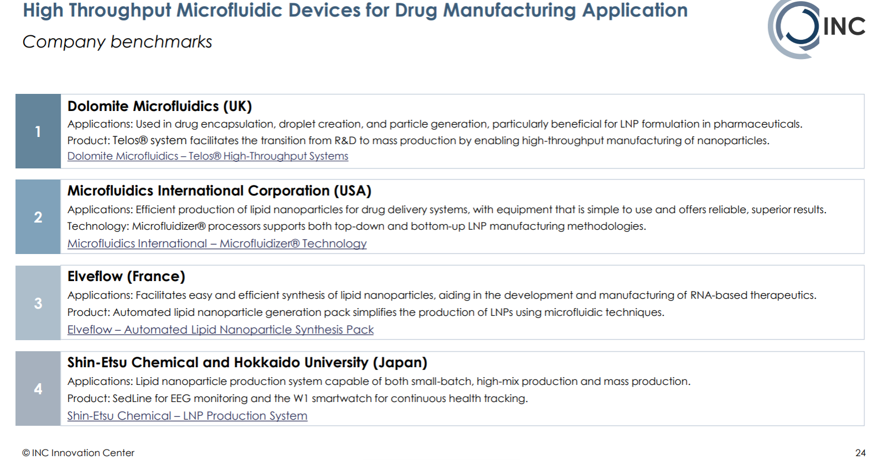

Slide 32
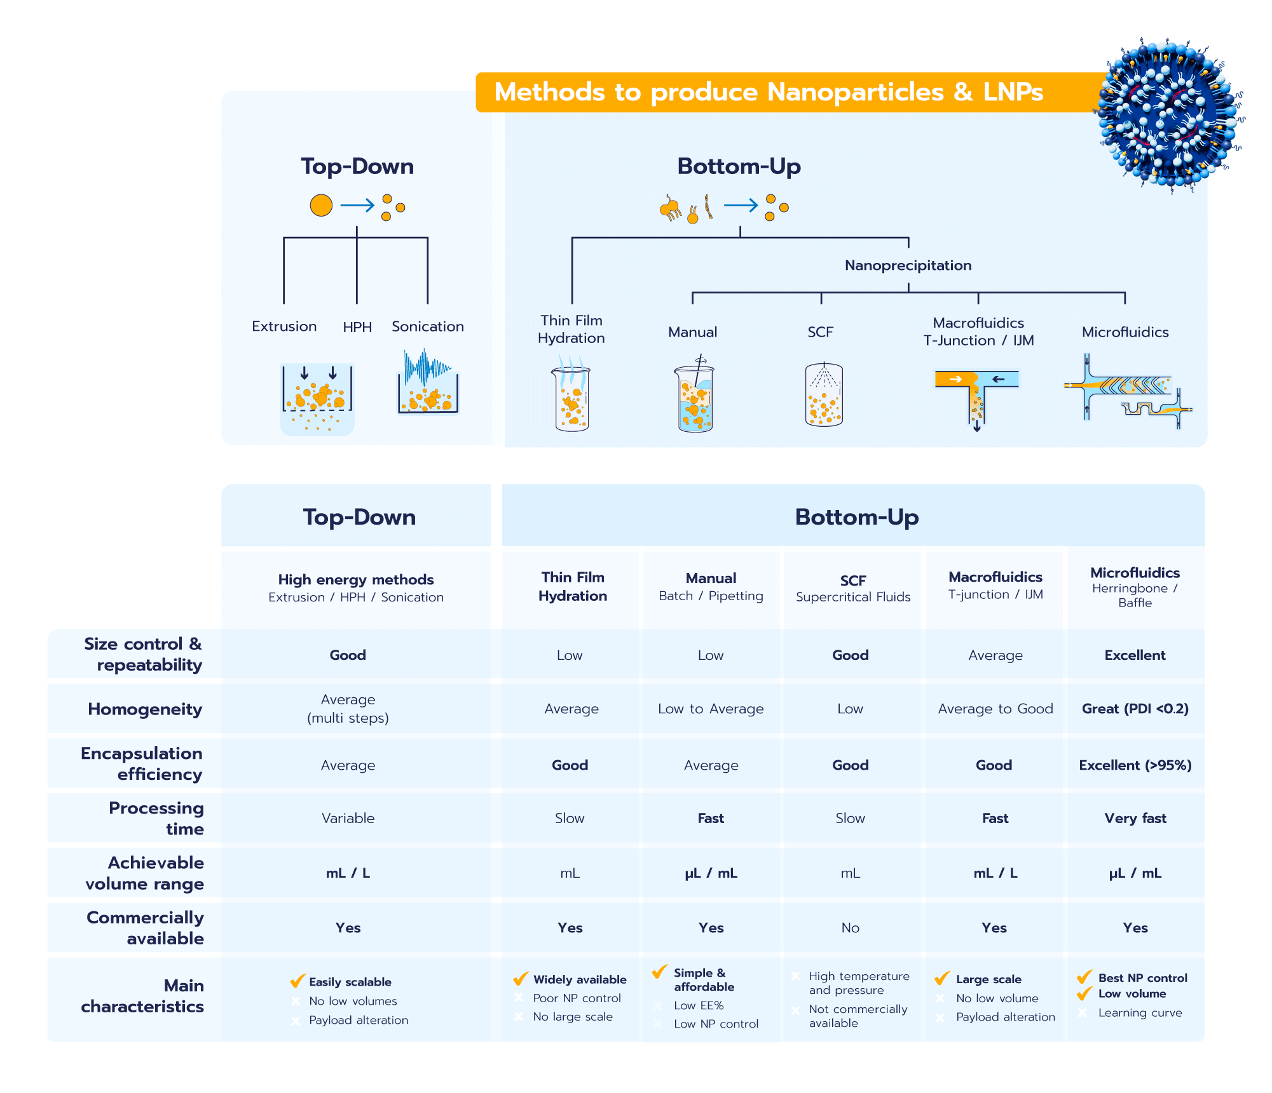

Slide 33
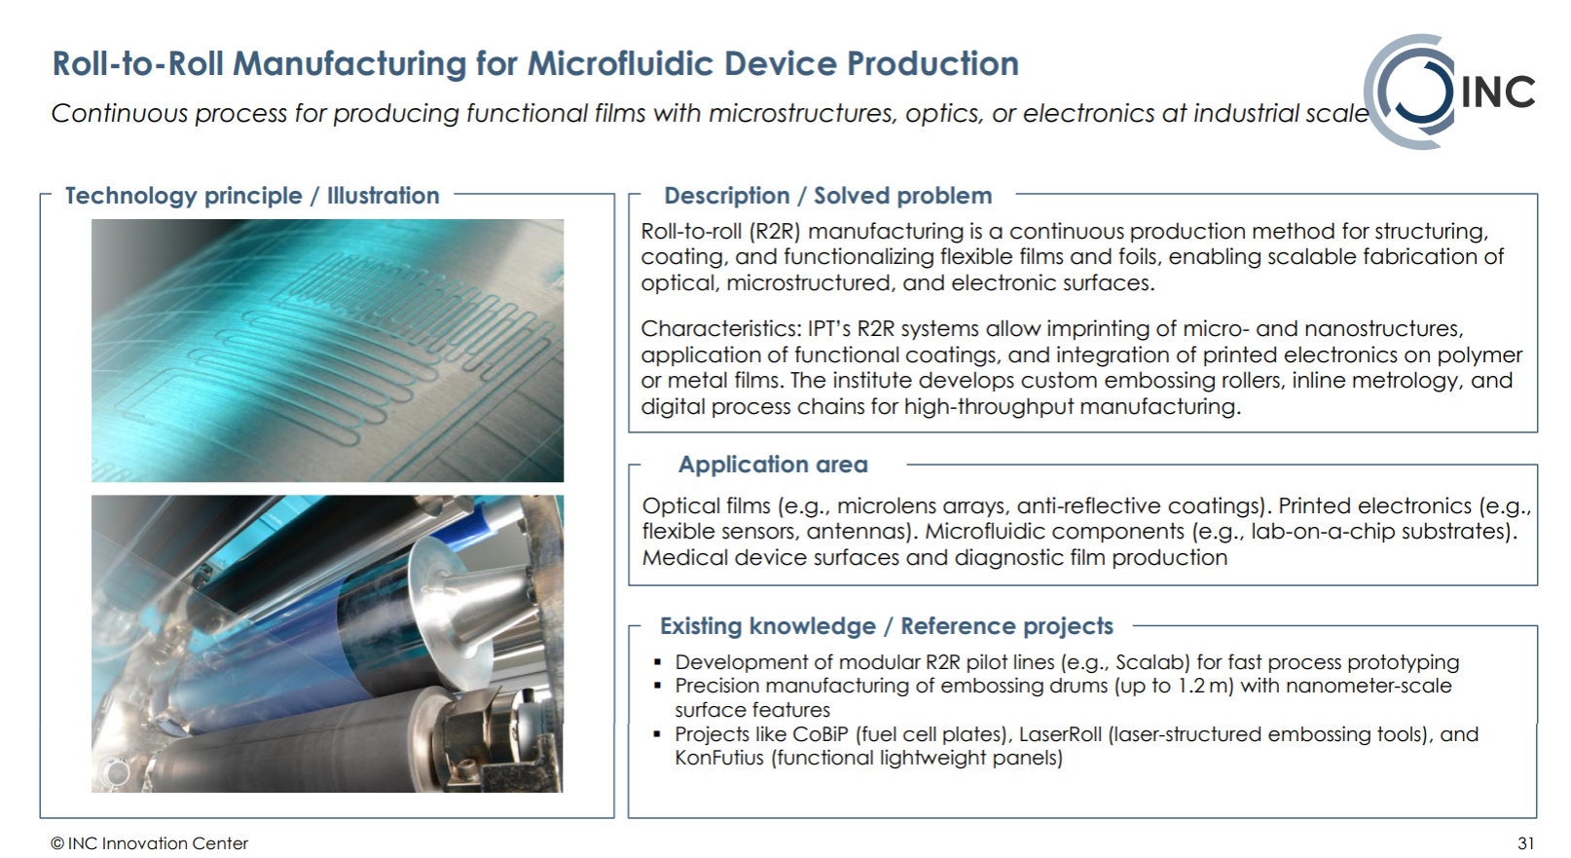

Slide 34
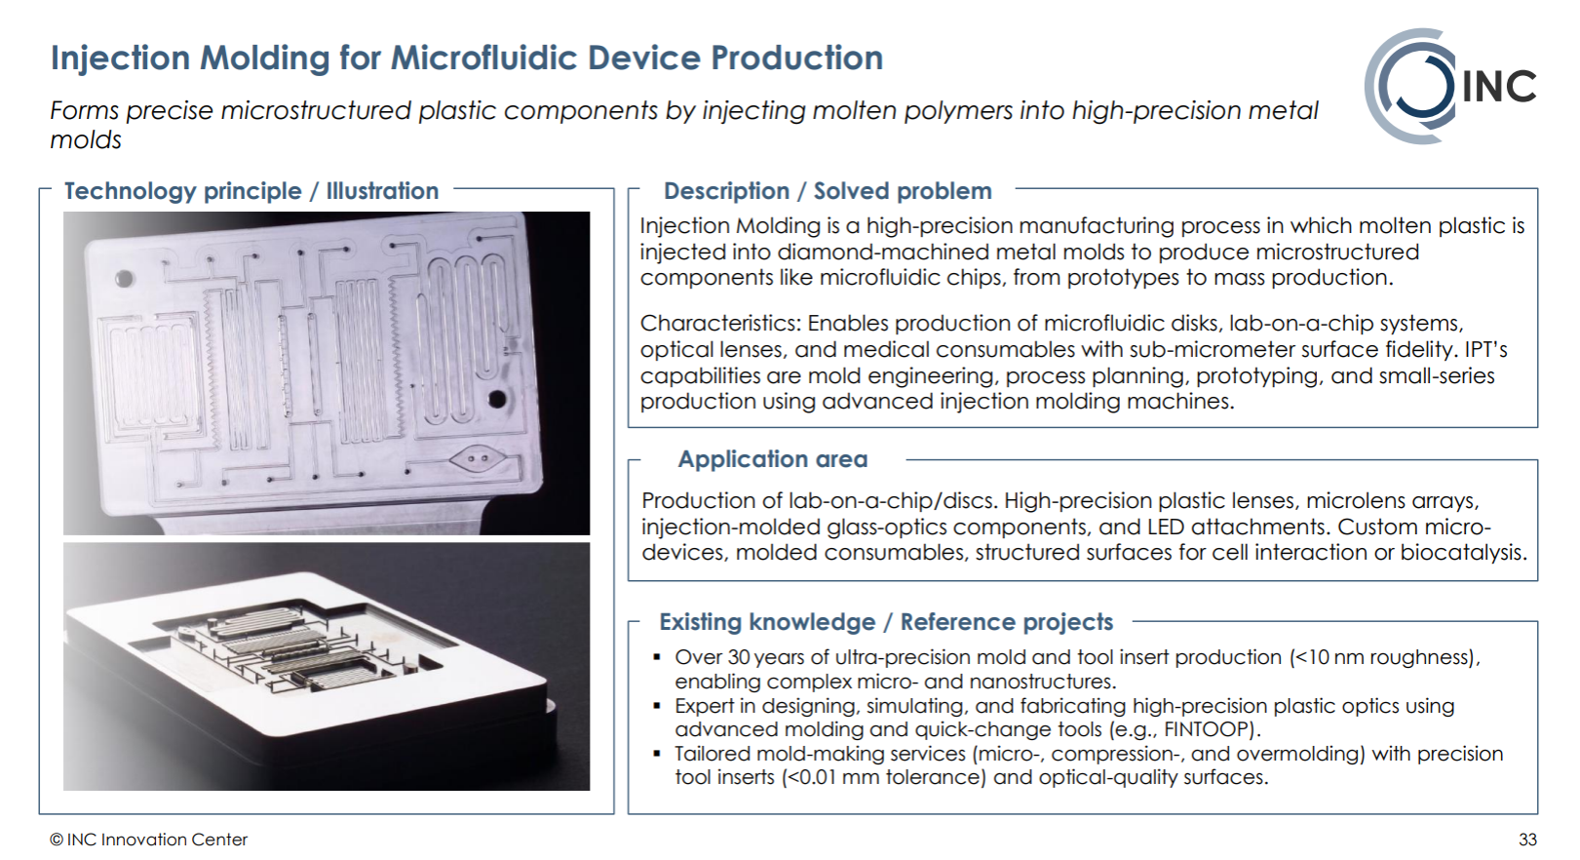

Slide 35
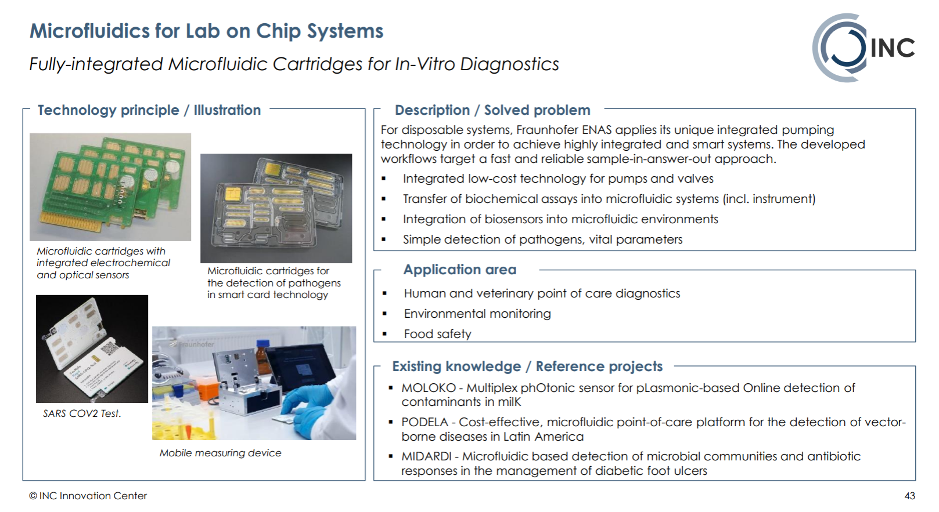

Slide 36
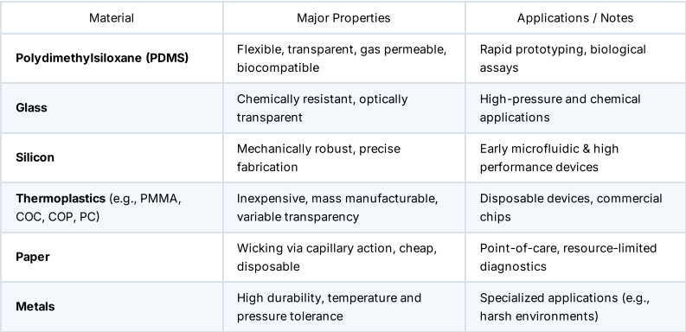
Materials
Potential Pain Points | Tolerance
Delicate and chemically permeable | ± 5 µm
Microfabrication difficulties; cost; labor intensive | ± 1 µm
Opacity renders it useless for optical applications. | ± 0.5 µm
Some manufacturing methods aren't great for mass production | ± 5 µm
Limited use case | N/A
Opaque, Microfabrication difficulties; Cost | ± 2 µm

Slide 37
R2R and Injection Molding
R2R process...
A liquid UV curable resin is uniformly deposited on a polymer-based substrate foil (PET, Kemafoil HSPL80).
A cylindrical imprint stamp is then continuously pressed into this liquid layer.
During stamp contact the resin is exposed by UV through the transparent PET substrate foil. This initiates the curing reaction, and the resin replicates the inverted pattern of the master.
During detaching from the imprint stamp, microfluidic channels are produced in a continuous way.
Injection molding...
Micro-injection moulding has the ability to produce large numbers of parts to small tolerance values with a high quality of surface finish. Hot melt polymeric material is injected at high pressure into a mould, allowed to cool, and then demoulded
Advantages of this production process include the replicability and cost effectiveness for mass scaling potential, especially for disposable products used for medical applications; the availability of a wide range of thermoplastics; and it being fully automated, reducing cycle time
Notes:
Kilas reference: R2R: MDPI and ACS Style
Smolka, M.; Ruttloff, S.; Nees, D.; Prietl, C.; Satzinger, V.; Lamprecht, B.; Hütter, P.; Hesse, J.; Kokkinis, G.; Kriechhammer, G.; et al. High Throughput Roll-to-Roll Production of Microfluidic Chips. Proceedings 2018, 2, 1054. https://doi.org/10.3390/proceedings2131054
Injection molding: Micro Injection Molding:Everything You Need to Know 1,2,3

